Slide 1

From Moonshot to Mars
Remy Bien
Ruben Bras
Sebastiaan Groot
Marvin Hiemstra
Wouter Miltenburg
Koen Veelenturf
1
Notes:
6/10/13

Slide 2

Table of content
Moonshot
Assignment
Preliminary research
JaNET’s Moonshot
FreeRADIUS Module
Notes:
6/10/13

Slide 3
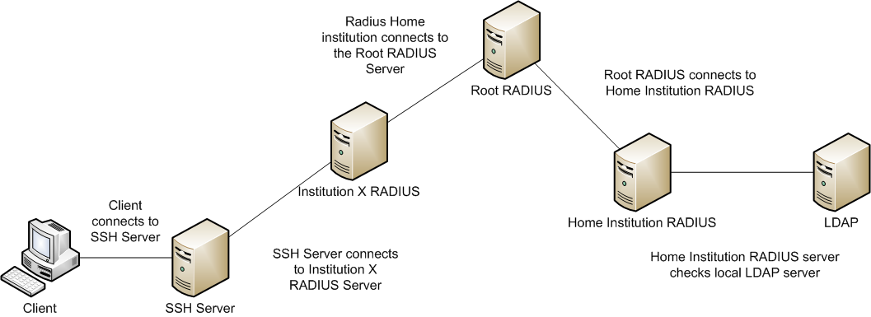
Moonshot
What is Moonshot?
How it should work
Notes:
6/10/13

Slide 4
Assignment
Goal
Scope
Notes:
6/10/13

Slide 5
Preliminary Research
GSS-API
Kerberos
RADIUS
EAP-TTLS
SSH
SAML
SurfConext / VOMS
Access Point Software
Eduroam
Spacenet
OpenSocial
JaNET

Slide 6
Preliminary Research
GSS-API
Kerberos
RADIUS
EAP-TTLS
SSH
SAML
SurfConext / VOMS
Access Point Software
Eduroam
Spacenet
OpenSocial
JaNET

Slide 7
OpenSSH Server 5.9p1
Moonshooting the server
Trying to understand internal authentication
Code analysis
Debugging
Existing solutions not secure and inflexible
JaNET already developing a solution

Slide 8


JaNET’s Moonshot
Organisation
Implementation
Progress
Found issues
Notes:
6/10/13
De kat heeft wat uitleg nodig, zie volgende slides… “Educative slide”

Slide 10
JaNET’s Moonshot: Organisation
ISP and research institution
JaNET’s Clients
Educational institutions
Research institutions
Moonshot development
Notes:
6/10/13

Slide 11
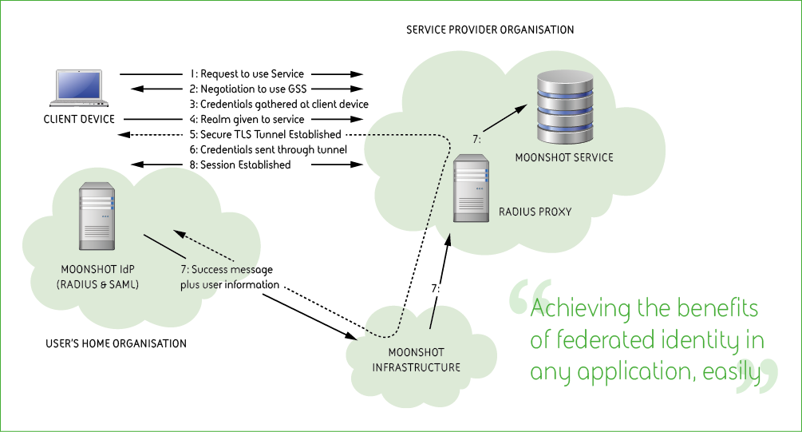
JaNET’s Moonshot Implementation
Notes:
6/10/13
Dit is hoe JaNET het heeft getekend… Volgende slide eigen interpretatie.

Slide 12
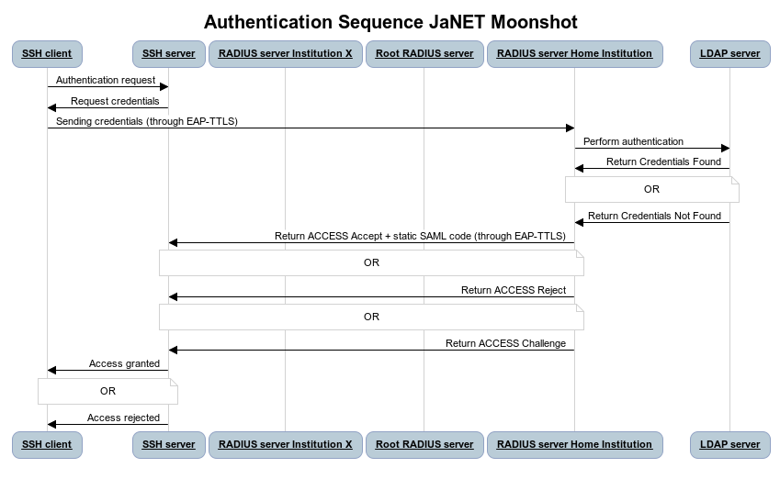
JaNET’s Moonshot Implementation
Notes:
6/10/13
SAML is static in LiveDVD, niet nodig, kan worden geautomatiseerd
GSS / SAML!
Laat zien dat verkeer door ALLE servers gaat!

Slide 13
JaNET’s Moonshot: Trust Router
Trust Router and Trust Router protocol
Trust Router thoughts

Slide 14
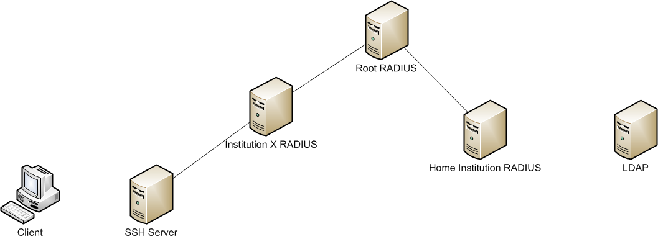
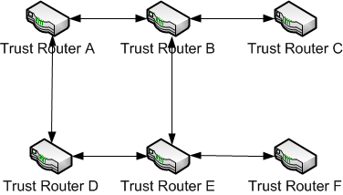
JaNET’s Moonshot: Trust Router
Trust Router
Notes:
6/10/13

Slide 15
Notes:
1. We start with a single federation including four realms, each realm contains a single trust router. The trust routers are peered in such a way that their interconnects form a multi-hop federations.
2. A subject with an example-g.org identity attempts to access a service provided by relying party Bar.
3. The relying Party does not have direct access to the example-g.org server that is can use to authenticate the subject, so it asks its local trust router to forward a Temporary Identity request
to example-g’s local trust router.
4. The intermediary trust router(s) forward the request along the trust path to the intended trust router.
5. The Example-g.org server receives the temporary from the local trust router and configures a temporary identity for the intended relying party.
6. The relying party can now reach the Example-g.org server to perform the authentication.

Slide 16
JaNET’s Moonshot: Trust Router thoughts
Anonimity
DoS
Trust router hack
Lack of documentation

Slide 17
JaNET’s Moonshot: JaNET’s Progress
Pilot DVD
OpenSSH
Moonshot UI
Debian “Wheezy” only – CentOS in development
Trust-router Beta
Documentation
Notes:
6/10/13

Slide 18
JaNET’s Moonshot: Found Issues
No recent CentOS packages
Moonshot-UI problems
“steve@local”
Certificate Validation
Compiling code
OpenSSH client problems
Work in progress (JaNET)
No Documentation
Notes:
6/10/13
Nikhef vroeg om CentOS oplossing
JaNET beweerde dat alles implementation-ready was incl. CentOS!
Found issues reported upstream to JaNET

Slide 19

FreeRADIUS Module
Introduction
Protocol specification
Proof of Concept
Future work
Notes:
6/10/13

Slide 20
FreeRADIUS Module: Introduction
Using regular RADIUS traffic
Third-party attribute providers
Easily implemented as modules on existing infrastructures
Notes:
6/10/13

Slide 21
FreeRADIUS Module: Protocol Specification
Three actors
Client
Proxy-RADIUS server
IDP-RADIUS server
Five states
Client: Sending Access-Request
Proxy: Proxying Access-Request
IDP: Evaluating the Access-Request
Proxy: Proxying the repose
Client: Evaluating the respons
Notes:
6/10/13

Slide 22
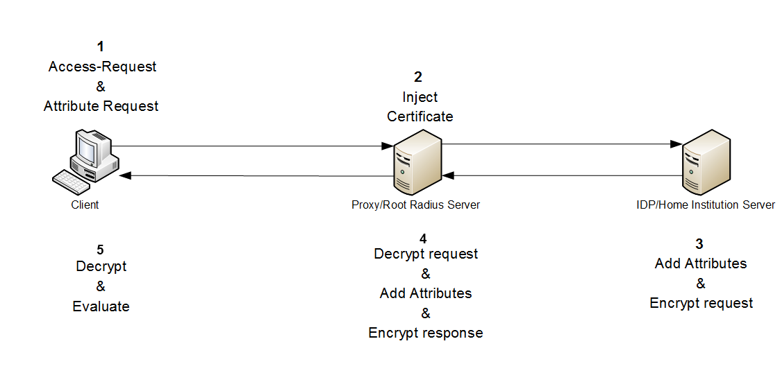

Slide 23
FreeRADIUS Module: Protocol Specification
URN formats:
Client request
Timestamp:Service DN:Proxy DN:Required Attibutes:Requested Attributes
IDP Response
Timestamp:Service DN:IDP DN:Provided AVPs:Requested Attributes
Proxy response
Timestamp:Proxy DN:Requested AVPs
Notes:
6/10/13

Slide 24
12345:DC=HVA,DC=NL,CN=SSHD:DC=SURFNET,DC=NL,CN=SurfConext:2: UserName:SurfConextPassword:1:SurfConextGroup
12352:DC=HVA,DC=NL,CN=SSHD:DC=NIKHEF,DC=NL,CN=RADIUSD:2:UserName=sgroot:SuftConextPassword=testing123:1:SurfConextGroup
12380:DC=SURFNET,DC=NL,CN=SurfConext:1:SurfConextGroup=HvAStudent
Notes:
6/10/13

Slide 25
12345:DC=HVA,DC=NL,CN=SSHD:DC=SURFNET,DC=NL,CN=SurfConext:2: UserName:SurfConextPassword:1:SurfConextGroup
12352:DC=HVA,DC=NL,CN=SSHD:DC=NIKHEF,DC=NL,CN=RADIUSD:2:UserName=sgroot:SuftConextPassword=testing123:1:SurfConextGroup
12380:DC=SURFNET,DC=NL,CN=SurfConext:1:SurfConextGroup=HvAStudent
Notes:
6/10/13

Slide 26
12345:DC=HVA,DC=NL,CN=SSHD:DC=SURFNET,DC=NL,CN=SurfConext:2: UserName:SurfConextPassword:1:SurfConextGroup
12352:DC=HVA,DC=NL,CN=SSHD:DC=NIKHEF,DC=NL,CN=RADIUSD:2:UserName=sgroot:SuftConextPassword=testing123:1:SurfConextGroup
12380:DC=SURFNET,DC=NL,CN=SurfConext:1:SurfConextGroup=HvAStudent
Notes:
6/10/13

Slide 27
12345:DC=HVA,DC=NL,CN=SSHD:DC=SURFNET,DC=NL,CN=SurfConext:2: UserName:SurfConextPassword:1:SurfConextGroup
12352:DC=HVA,DC=NL,CN=SSHD:DC=NIKHEF,DC=NL,CN=RADIUSD:2:UserName=sgroot:SuftConextPassword=testing123:1:SurfConextGroup
12380:DC=SURFNET,DC=NL,CN=SurfConext:1:SurfConextGroup=HvAStudent
Notes:
6/10/13

Slide 28
12345:DC=HVA,DC=NL,CN=SSHD:DC=SURFNET,DC=NL,CN=SurfConext:2: UserName:SurfConextPassword:1:SurfConextGroup
12352:DC=HVA,DC=NL,CN=SSHD:DC=NIKHEF,DC=NL,CN=RADIUSD:2:UserName=sgroot:SuftConextPassword=testing123:1:SurfConextGroup
12380:DC=SURFNET,DC=NL,CN=SurfConext:1:SurfConextGroup=HvAStudent
Notes:
6/10/13

Slide 29
12345:DC=HVA,DC=NL,CN=SSHD:DC=SURFNET,DC=NL,CN=SurfConext:2: UserName:SurfConextPassword:1:SurfConextGroup
12352:DC=HVA,DC=NL,CN=SSHD:DC=NIKHEF,DC=NL,CN=RADIUSD:2:UserName=sgroot:SuftConextPassword=testing123:1:SurfConextGroup
12380:DC=SURFNET,DC=NL,CN=SurfConext:1:SurfConextGroup=HvAStudent
Notes:
6/10/13

Slide 30
12345:DC=HVA,DC=NL,CN=SSHD:DC=SURFNET,DC=NL,CN=SurfConext:2: UserName:SurfConextPassword:1:SurfConextGroup
12352:DC=HVA,DC=NL,CN=SSHD:DC=NIKHEF,DC=NL,CN=RADIUSD:2:UserName=sgroot:SuftConextPassword=testing123:1:SurfConextGroup
12380:DC=SURFNET,DC=NL,CN=SurfConext:1:SurfConextGroup=HvAStudent
Notes:
6/10/13

Slide 31
12345:DC=HVA,DC=NL,CN=SSHD:DC=SURFNET,DC=NL,CN=SurfConext:2: UserName:SurfConextPassword:1:SurfConextGroup
12352:DC=HVA,DC=NL,CN=SSHD:DC=NIKHEF,DC=NL,CN=RADIUSD:2:UserName=sgroot:SuftConextPassword=testing123:1:SurfConextGroup
12380:DC=SURFNET,DC=NL,CN=SurfConext:1:SurfConextGroup=HvAStudent
Notes:
6/10/13

Slide 32
12345:DC=HVA,DC=NL,CN=SSHD:DC=SURFNET,DC=NL,CN=SurfConext:2: UserName:SurfConextPassword:1:SurfConextGroup
12352:DC=HVA,DC=NL,CN=SSHD:DC=NIKHEF,DC=NL,CN=RADIUSD:2:UserName=sgroot:SuftConextPassword=testing123:1:SurfConextGroup
12380:DC=SURFNET,DC=NL,CN=SurfConext:1:SurfConextGroup=HvAStudent
Notes:
6/10/13

Slide 33
12345:DC=HVA,DC=NL,CN=SSHD:DC=SURFNET,DC=NL,CN=SurfConext:2: UserName:SurfConextPassword:1:SurfConextGroup
12352:DC=HVA,DC=NL,CN=SSHD:DC=NIKHEF,DC=NL,CN=RADIUSD:2:UserName=sgroot:SuftConextPassword=testing123:1:SurfConextGroup
12380:DC=SURFNET,DC=NL,CN=SurfConext:1:SurfConextGroup=HvAStudent
Notes:
6/10/13

Slide 34
12345:DC=HVA,DC=NL,CN=SSHD:DC=SURFNET,DC=NL,CN=SurfConext:2: UserName:SurfConextPassword:1:SurfConextGroup
12352:DC=HVA,DC=NL,CN=SSHD:DC=NIKHEF,DC=NL,CN=RADIUSD:2:UserName=sgroot:SuftConextPassword=testing123:1:SurfConextGroup
12380:DC=SURFNET,DC=NL,CN=SurfConext:1:SurfConextGroup=HvAStudent
Notes:
6/10/13

Slide 35
12345:DC=HVA,DC=NL,CN=SSHD:DC=SURFNET,DC=NL,CN=SurfConext:2: UserName:SurfConextPassword:1:SurfConextGroup
12352:DC=HVA,DC=NL,CN=SSHD:DC=NIKHEF,DC=NL,CN=RADIUSD:2:UserName=sgroot:SuftConextPassword=testing123:1:SurfConextGroup
12380:DC=SURFNET,DC=NL,CN=SurfConext:1:SurfConextGroup=HvAStudent
Notes:
6/10/13

Slide 36
12345:DC=HVA,DC=NL,CN=SSHD:DC=SURFNET,DC=NL,CN=SurfConext:2: UserName:SurfConextPassword:1:SurfConextGroup
12352:DC=HVA,DC=NL,CN=SSHD:DC=NIKHEF,DC=NL,CN=RADIUSD:2:UserName=sgroot:SuftConextPassword=testing123:1:SurfConextGroup
12380:DC=SURFNET,DC=NL,CN=SurfConext:1:SurfConextGroup=HvAStudent
Notes:
6/10/13

Slide 37
FreeRADIUS Module: Protocol Specification
Message formats
MIME plain text
SMIME signed & encrypted plain text
SMIME certificate-only
Notes:
6/10/13

Slide 38
FreeRADIUS Module: Future work
Enabling SMIME decryption / validation support
Supporting multiple RADIUS proxy servers
Diffie-Hellman Key Exchange
Client implementation
User or service as client
LDAP / VOMS / SurfConext implementations
Notes:
6/10/13

Slide 39
FreeRADIUS Module: Proof of Concept
Live Demonstration
Wireshark analysis
Notes:
6/10/13

Slide 40
Questions?
Notes:
6/10/13

